Slide 1


202X
油画质感工作总结汇报
PRESS CONFERENCE LEVEL BUSINESS SUMMARY REPORT
By faith I mean a vision of good one cherishes and the enthusiasm that pushes one to seek its fulfillment regardless of obstacles. By faith I By faith I mean a vision of good one cherishes and the enthusiasm that

Slide 2
CONTENTS
Text here
Text here
Text here
Text here
Copy paste fonts. Choose the only option to retain text.
Copy paste fonts. Choose the only option to retain text.
Copy paste fonts. Choose the only option to retain text.
Copy paste fonts. Choose the only option to retain text.

Slide 3
01
ANALYSIS
Studio is a fast way to start your responsive web design projects that harnesses the power of Sass and Compass.

Slide 4




Description text
Our
Professionals
Designer team
Roger Bratislava
Olufemi Zawisza
Bodil Caitlin
Florian Iolyn
UI/UX Designer
Web Designer
Writer
Photographer

Slide 5

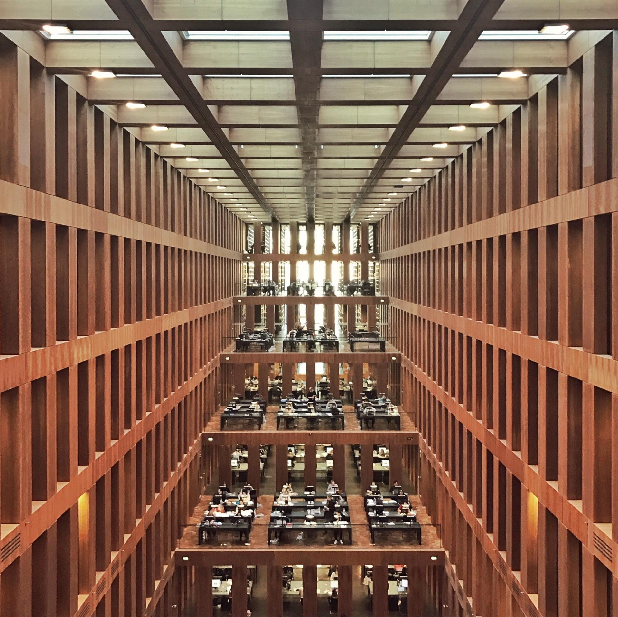


UNIFIED FONTS MAKE READING MORE FLUENT.
Theme color makes PPT more convenient to change.
Adjust the spacing to adapt to Chinese typesetting, use the reference line in PPT.
Text here
Text here
Text here
Text here
Copy paste fonts. Choose the only option to retain text.
Copy paste fonts. Choose the only option to retain text.
Copy paste fonts. Choose the only option to retain text.
Copy paste fonts. Choose the only option to retain text.

Slide 6




“
Text here
Text here
Text here
Copy paste fonts. Choose the only option to retain text……
Copy paste fonts. Choose the only option to retain text……
Adjust the spacing to adapt to Chinese typesetting, use the reference line in PPT.
……
Text here
Text here
Copy paste fonts. Choose the only option to retain text……
Copy paste fonts. Choose the only option to retain text……
“

Slide 7
02
ANALYSIS
Studio is a fast way to start your responsive web design projects that harnesses the power of Sass and Compass.

Slide 8




Text here
Text here
Copy paste fonts. Choose the only option to retain text.
… …
Copy paste fonts. Choose the only option to retain text.
… …
Text here
Text here
Copy paste fonts. Choose the only option to retain text.
… …
Copy paste fonts. Choose the only option to retain text.
… …

Slide 9
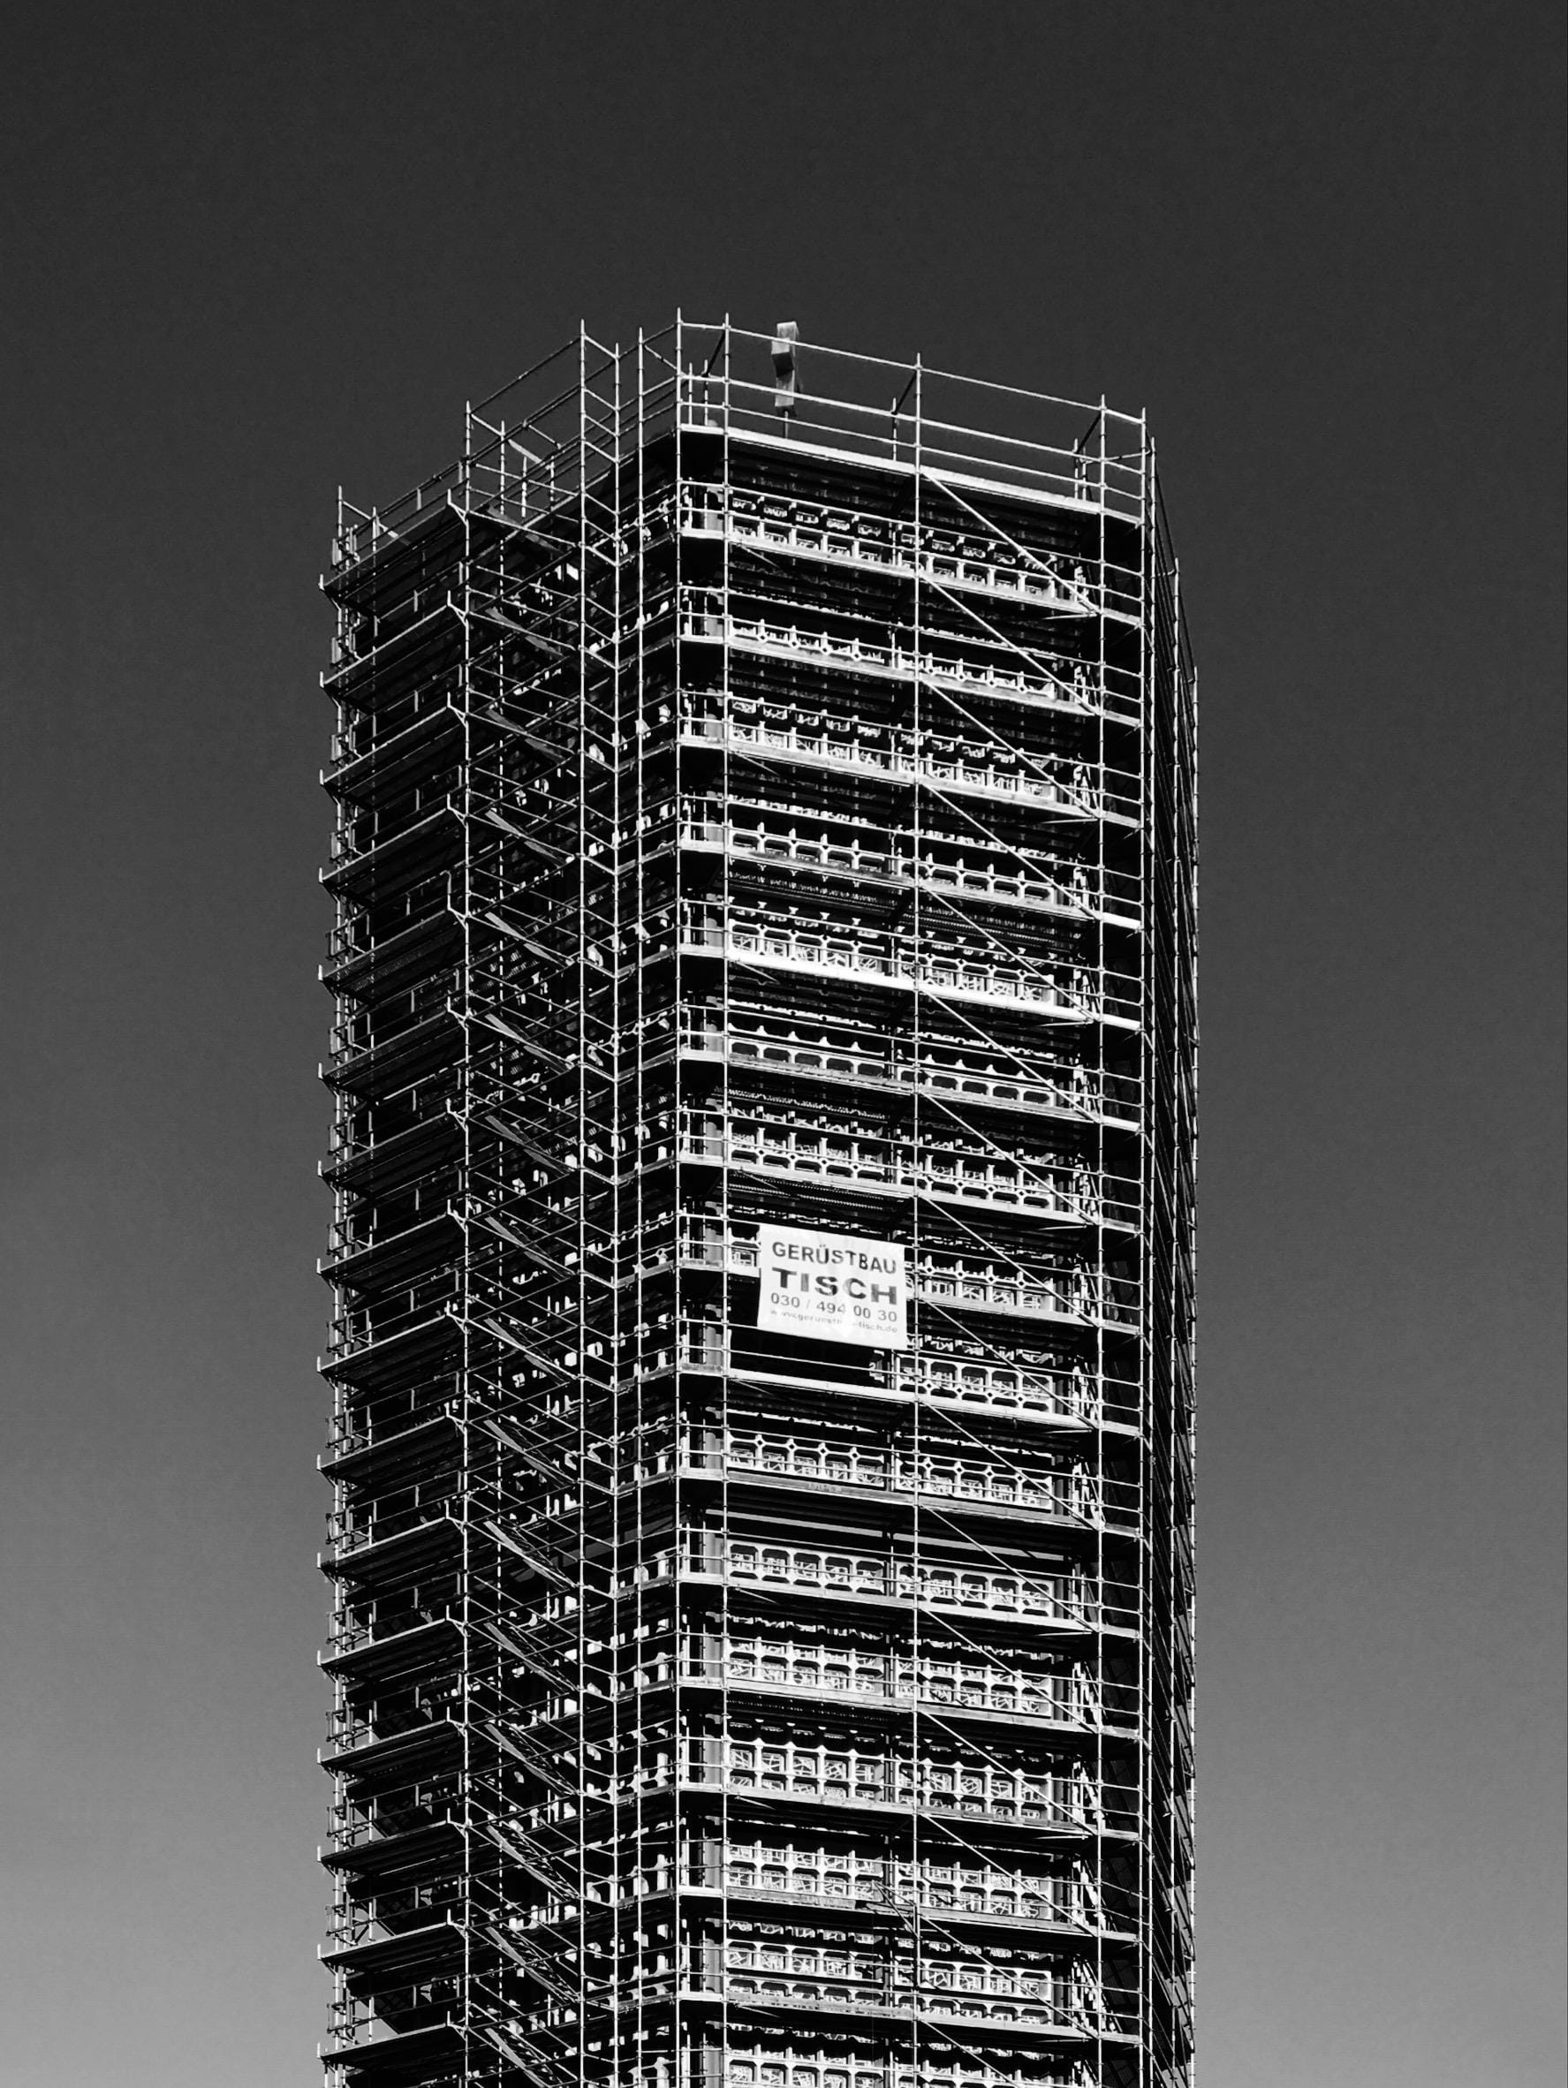



01.Text here
Copy paste fonts. Choose the only option to retain text……
04.Text here
Copy paste fonts. Choose the only option to retain text……
02.Text here
Copy paste fonts. Choose the only option to retain text……
03.Text here
Copy paste fonts. Choose the only option to retain text……

Slide 10

Supporting text here.
Unified Fonts Make Reading More Fluent.
Text here
Theme color makes PPT more convenient to change.Adjust the spacing to adapt to Chinese typesetting, use the reference line in PPT.
……

Slide 11
03
ANALYSIS
Studio is a fast way to start your responsive web design projects that harnesses the power of Sass and Compass.

Slide 12


Text here
Text here
Copy paste fonts. Choose the only option to retain text.
… …
Copy paste fonts. Choose the only option to retain text.
… …
Text here
Text here
Copy paste fonts. Choose the only option to retain text.
… …
Copy paste fonts. Choose the only option to retain text.
… …
Unified Fonts Make Reading More Fluent.

Slide 13
03.Text here
Copy paste fonts. Choose the only option to retain text……
02.Text here
Copy paste fonts. Choose the only option to retain text……
01.Text here
Copy paste fonts. Choose the only option to retain text……
UNIFIED FONTS MAKE
READING MORE FLUENT.

Slide 14
Text here
Text here
Copy paste fonts. Choose the only option to retain text.
Copy paste fonts. Choose the only option to retain text.
Text here
Text here
Copy paste fonts. Choose the only option to retain text.
Copy paste fonts. Choose the only option to retain text.
UNIFIED FONTS MAKE READING MORE FLUENT.
Theme color makes PPT more convenient to change.Adjust the spacing to adapt to Chinese typesetting,
use the reference line in PPT.

Slide 15
04
ANALYSIS
Studio is a fast way to start your responsive web design projects that harnesses the power of Sass and Compass.

Slide 16
Text here
Text here
Supporting text here.
… …
Supporting text here.
… …
Text here
Text here
Supporting text here.
… …
Supporting text here.
… …

Slide 17

Unified fonts make reading more fluent.
Theme color makes PPT more convenient to change.Adjust the spacing to adapt to Chinese typesetting, use the reference line in PPT.
……
Text here
Text here
Text here
Text here

Slide 18

Text here
Copy paste fonts. Choose the only option to retain text.
Text here
Text here
Copy paste fonts. Choose the only option to retain text.
Copy paste fonts. Choose the only option to retain text.
Text here
Text here
Copy paste fonts. Choose the only option to retain text.
Copy paste fonts. Choose the only option to retain text.

Slide 19
202X
感谢您的欣赏
PRESS CONFERENCE LEVEL BUSINESS SUMMARY REPORT
By faith I mean a vision of good one cherishes and the enthusiasm that pushes one to seek its fulfillment regardless of obstacles. By faith I By faith I mean a vision of good one cherishes and the enthusiasm that

